Slide 1
Rockbuster Stealth Database Analysis
Presented by
Nnaji Igwenagu

Slide 2
Project overview Objectives Company overview General Analysis Concl.& Recomm
Rockbuster Stealth LLC is a movie rental company that used to have stores around the world. Facing stiff competition from streaming services such as Netflix and Amazon Prime, the Rockbuster Stealth management team is planning to use its existing movie licenses to launch an online video rental service in order to stay competitive.

Slide 3
Project overview Objectives Company overview General Analysis Concl.& Recomm
Objectives and key questions
The Rockbuster Stealth Management Board has asked a series of business questions and
they expect data-driven answers that they can use for their 2020 company strategy. Here are some key questions that I would like to use to address the issue.
Rating Analysis
Which are the top 5 ratings of the film?
Genre Analysis
Which movies contributed most/least to revenue gain?
Customer Analysis
Where are customers with a high lifetime value based?
Location Analysis
Which countries are Rockbuster customers based in?
Spatial Analysis
Do sales figures vary between geographic regions?

Slide 4
Project overview Objectives Company overview General Analysis Concl.& Recomm
The following details are the company`s information
Total Customers: 599
Films for Rent: 1000
Average Rental Duration: 5 days
Average Rental Cost: $2.98
Average Replacement Cost: $19.98

Slide 5
Project overview Objectives Company overview General Analysis Concl.& Recomm
Rating Analysis
The top rating of the film here is PG-13 with 223 count rating, meaning that PG/13, has been rated as the best in terms of quality, standard and performance.

Slide 6
Project overview Objectives Company overview General Analysis Concl.& Recomm
Genre Analysis
Total revenue generated by genres
Total number of filmsby genres
From the visulization above, the top 3 grnres that generated the most reveneue and the most number of films are the sports, Sci-Fi and the Animation, as shown in the left figure.

Slide 7
Project overview Objectives Company overview General Analysis Concl.& Recomm
Customer Analysis
The customer result, shows that the customer with highest revenue paid to the company is Eleanor Hunt from Renion, this might be quite unexpected as Runion is no way close to the top counties in the world. However, there is not much information to explain the reason behind her generating the highest revenue to the company.

Slide 8
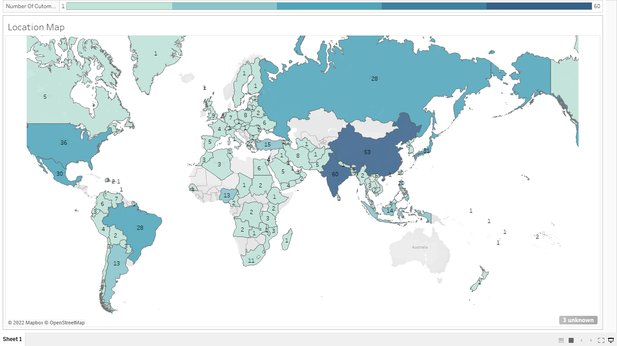
Project overview Objectives Company overview General Analysis Concl.& Recomm
Location Analysis
From the Map, it is very clear that customers are distributed around the world, however, India has the most customers at 60, followed by China with 53 and the United States with 36

Slide 9
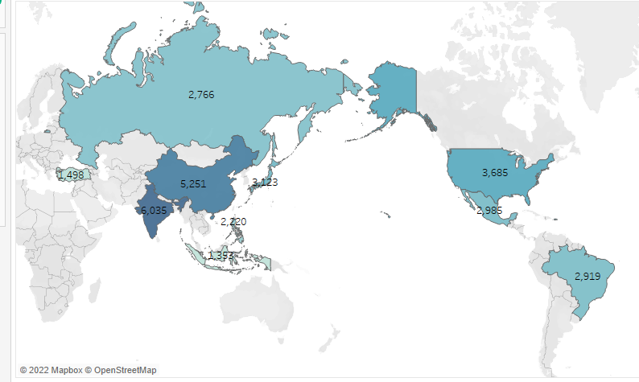
Project overview Objectives Company overview General Analysis Concl.& Recomm
Spatial Analysis
The above map shows the top 10 countries in revenue

Slide 10
Project overview Objectives Company overview General Analysis Concl.& Recomm
Conclusion and recommendation
Conclusion
The PG-13, remain the highest rating in terms of quality, standard and performance
The highest top 5 customer count comes from India, China, US, Japan and Mexico.
The business of Rockbuster covers alot of Countries, however, there is always room for more improvement.
Recommendation
They should target markets with high customer count and revenue generation: such as India, China, US, Japan, Mexico etc.
They should work on getting more licenses for more films in the most popular genres: such as Sports, Sci-Fi, Animation, Drama, Comedy etc.
They should also increase their popularity in areas they are not know

Slide 11
Tableau link
Rockbuster Stealth_Tableau

